Slide 1
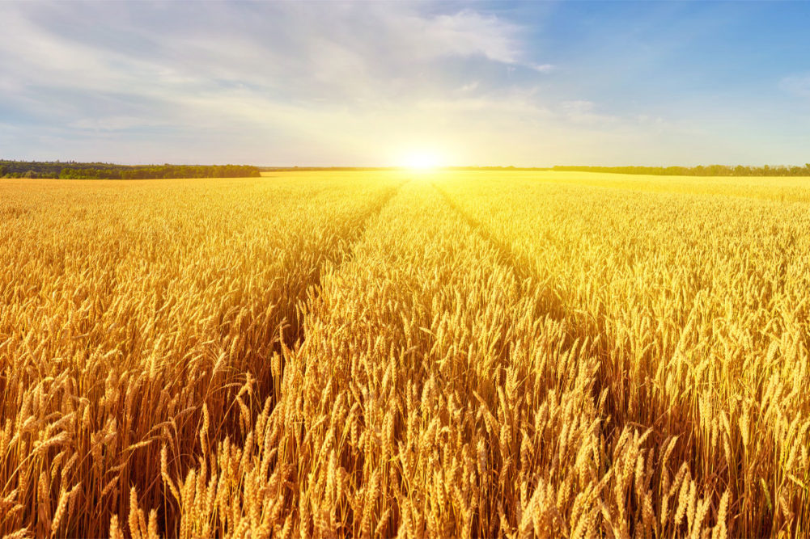

Slide 2
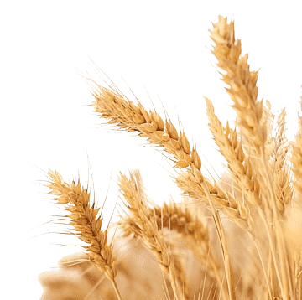
Wheat Detection Project
segmentation
Augmentation
Learn how can we make segmentation manually
Learn what are the augmentation process we need
Our
goals
Train Models
Onnx inference
Learn how train three of SOTA models
Learn how make inference using onnx

Slide 3
Our Pipeline

Slide 4
Our Pipeline
Download data from Kaggle

Slide 5
Our Pipeline
Segmentation Images
Download data from Kaggle

Slide 6
Export
annotation
Our Pipeline
Segmentation Images
Download data from Kaggle

Slide 7
Augmentation
Our Pipeline
Export
annotation
Segmentation Images
Download data from Kaggle

Slide 8
Train Models
Augmentation
Our Pipeline
Export
annotation
Segmentation Images
Download data from Kaggle

Slide 9
Augmentation
Our Pipeline
Train Models
Export
annotation
Segmentation Images
Evaluate Models
Download data from Kaggle

Slide 10
Augmentation
Our Pipeline
Train Models
Export
annotation
Segmentation Images
Evaluate Models
Download data from Kaggle
Save best
weights

Slide 11
Augmentation
Our Pipeline
Train Models
Export
annotation
Segmentation Images
Evaluate Models
Download data from Kaggle
Save best
weights
Convert to
ONNX

Slide 12
Augmentation
Our Pipeline
Train Models
Export
annotation
Segmentation Images
Evaluate Models
Download data from Kaggle
Save best
weights
Convert to
ONNX
Test using
ONNX inference

Slide 13
Augmentation
Our Pipeline
Train Models
Export
annotation
Segmentation Images
Evaluate Models
Download data from Kaggle
Save best
weights
Convert to
ONNX
Test using
ONNX inference

Slide 14
Export
annotation
Segmentation Images
Augmentation
Test using
ONNX inference
Convert to
ONNX
Download data from Kaggle
Train Models
Evaluate Models
Our Pipeline
Save best
weights

Slide 15
Download data
from Kaggle

Slide 16
Download data
from Kaggle
Train : 3422 images
Test : 10 images
The Global Wheat Head Dataset is led by nine research institutes from seven countries: the University of Tokyo, Institute national de recherche pour agriculture, alimentation et environment, Arvalis, ETHZ, University of Saskatchewan, University of Queensland, Nanjing Agricultural University, and Roth Amsted Research. These institutions are joined by many in their pursuit of accurate wheat head detection, including the Global Institute for Food Security, Digi tag, Kubota, and Hyphen.

Slide 17
Image segmentation

Slide 18
Image
segmentation
We used CVAT to annotate our image.
In CVAT there are three methods to annotate images: polygon, ai tool, using pre-trained model.

Slide 19
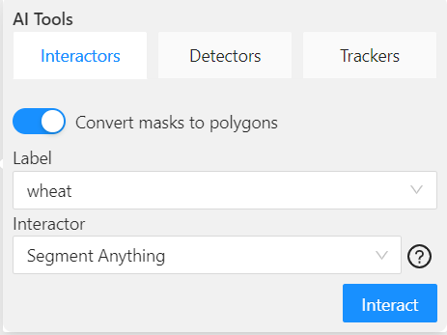
To achieve one of the purposes of this project which is to learn how make manual annotation we used polygon annotation for 200 images then we use ai tool to complete out data annotation.
AI tool

Slide 20
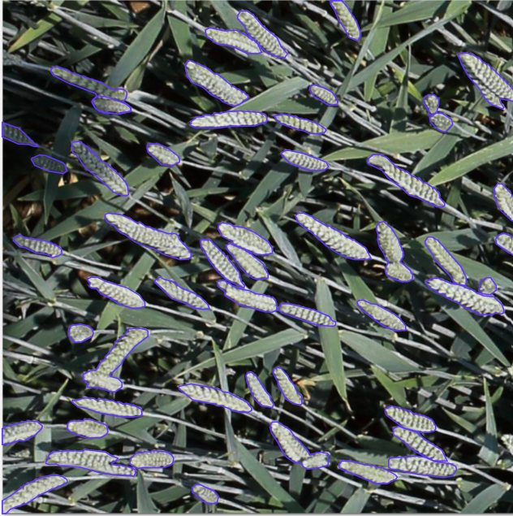
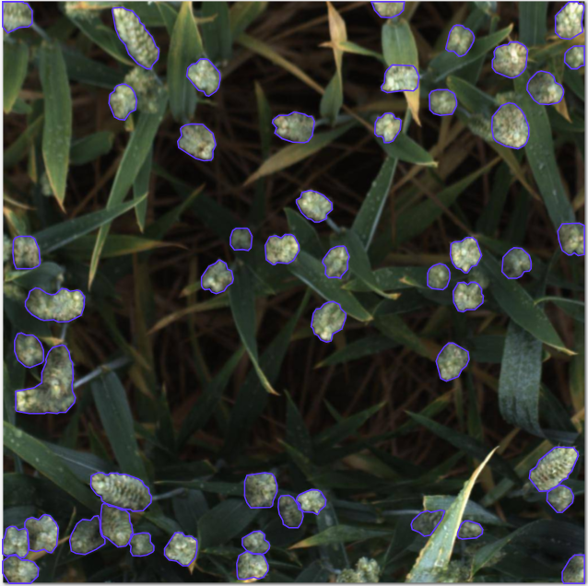
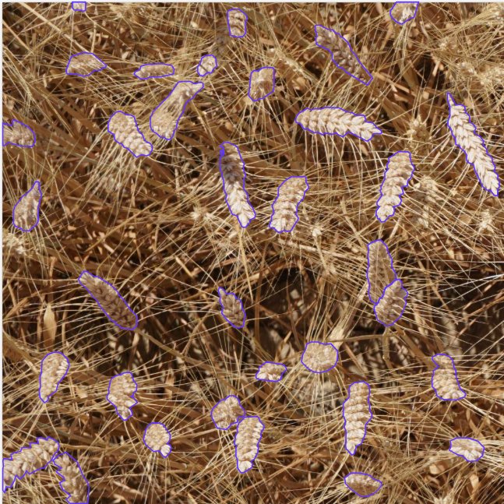
AI tool
Samples from annotation using ai tool.

Slide 21
AI tool
Samples from annotation using ai tool.

Slide 22
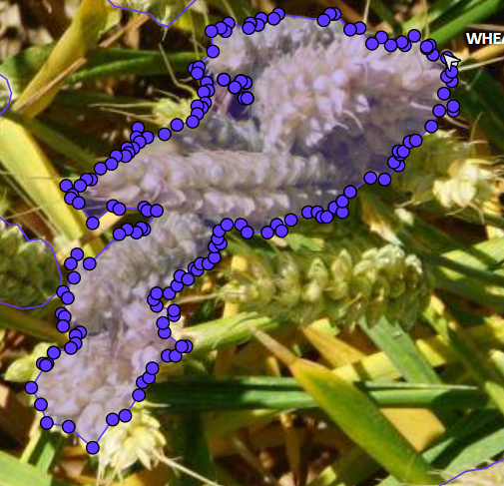
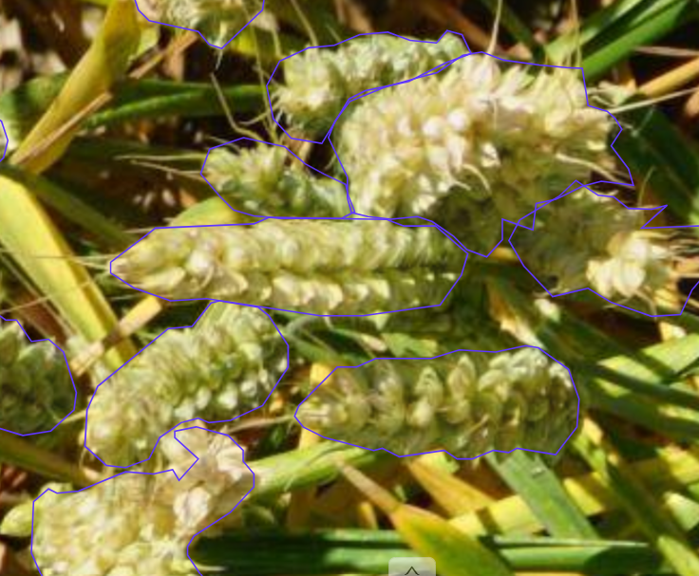
AI tool
The annotation doesn’t fully based on ai tool

Slide 23
Number of annotations examples
27 images → 875 annotations
49 images → 1766 annotations
138 images → 4893 annotations

Slide 24
Export annotations

Slide 25
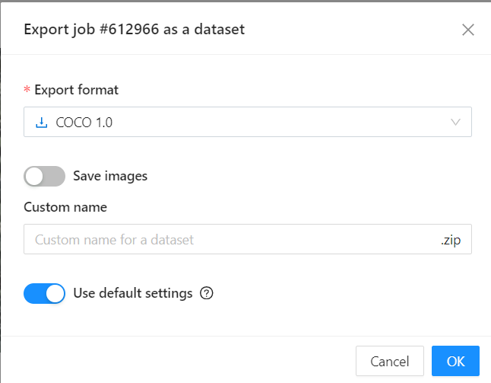
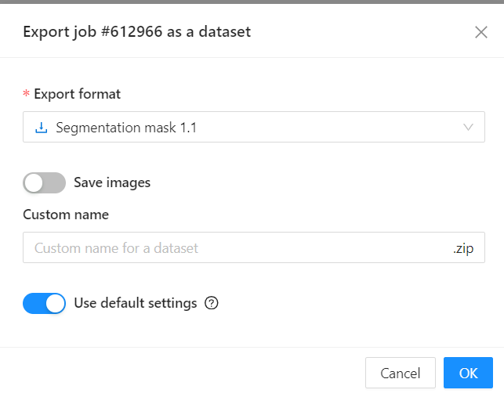
Choose the best annotated format from CVAT
To get json file
To get masks

Slide 26
Augmentation

Slide 27
Augmentation
It is a process to increase the number of training data.
This process is changes based on the training model we used.
We will explained in details in the next section.

Slide 28
Train Models

Slide 29
Training models
Total number of images that we annotated → 2651 images.
We used three models: yolov8-seg, U-Net and SAM.
models
YOLOV8-seg
YOLOV8n-seg
YOLOV8s-seg
U-Net
From scratch
SAM
YOLOV8l-seg
YOLOV8m-seg
Fine-tuning

Slide 30
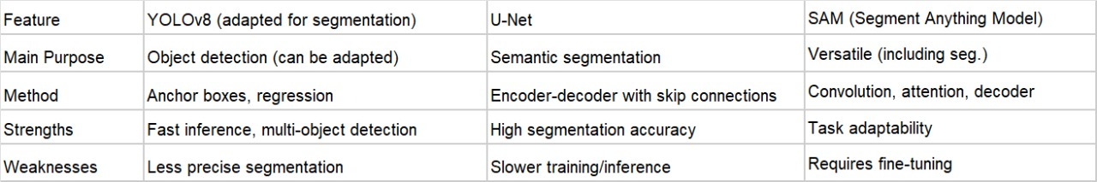
Difference between models

Slide 31
Yolov8-seg:
we used the json format from CVAT.
we upload the images and json file to Roboflow to preprocess and augment dataset.
split the dataset (70:30)
we worked on different number of samples (1198, 1500, 2651).
Preprocess and augment dataset
Download the dataset
Train the model

Slide 32
Yolov8-seg:
Number of samples | Number of augmentation images
1198 | 2830
1500 | 4200
2651 | 6390

Slide 33
U-Net from scratch
We used the segmentation mask format from the CVAT.
We worked on 2651 images with their masks.
Split the dataset
(80:20)
Train the model
Augmentation using ImageDataGenerator:
1- horizontal flip
2- vertical flip
3- fill mode
Preprocess the data:
1- scaling images.
2- Converting Mask to One-Hot Encoding

Slide 34
U-Net with fine-tuning
We used the segmentation mask format from the CVAT.
We worked on 2651 images with their masks.
Split the dataset
(80:20)
Train the model
No augmentation
initializes the U-Net model using MobileNetV2 as the encoder

Slide 35
We tried to train SAM model but had some problems and we didn’t have good results.
SAM
Data Splitting
(80:20)
Training SAM model
We used the segmentation mask format from the CVAT.
We used the segmentation mask format from the CVAT.

Slide 36
Model EVALUATION

Slide 37
YOLOV8-seg
Model / dataset | 1198 images | 1500 images | 2651 images
Yolov8n-seg | MapT:86.8% MapV:86.4% | MapT:88.3% MapV:83.4% | MapT:89.7% MapV:89.7%
Yolov8s-seg | MapT:88.8% MapV:88.9% | MapT:89.8% MapV:84.9% | MapT:90.5% MapV:89.8%
Yolov8m-seg | MapT:90.9% MapV:90% | MapT:90.2% MapV:90.1% | MapT:90.7% MapV:87.7%
Yolov8l-seg | MapT:91.9% MapV:91% | MapT:91.4% MapV:91.1% | MapT:90.9% MapV:91%

Slide 38
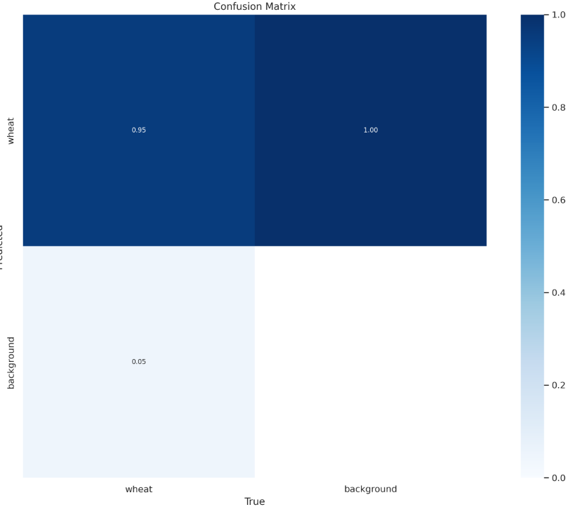
Yolov8l-seg with 2651 samples
Confusion matrix

Slide 39
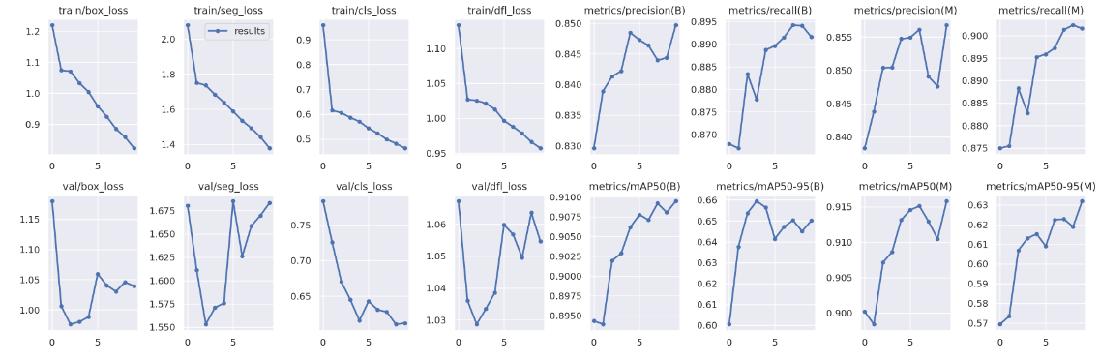
Yolov8l-seg Results

Slide 40
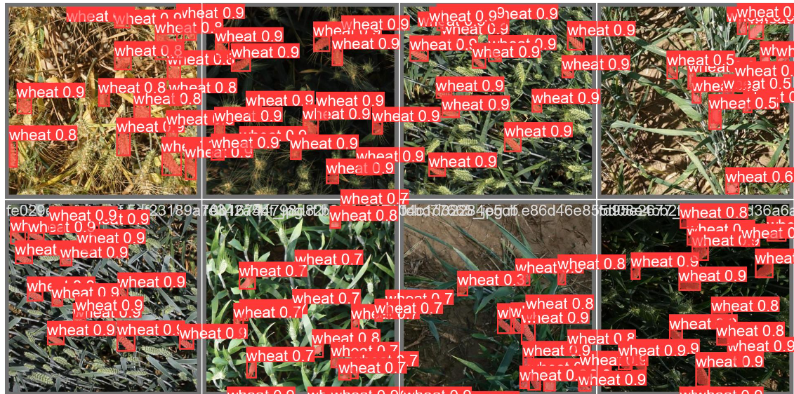
Yolov8l-seg validation samples

Slide 41
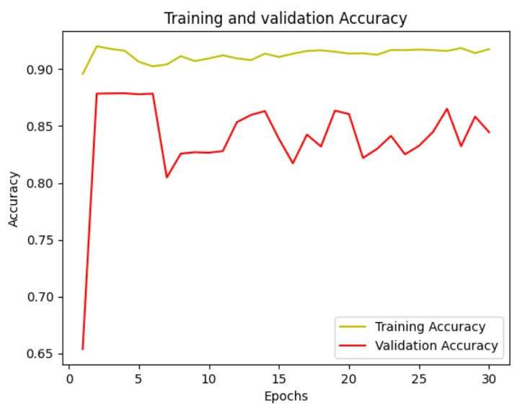
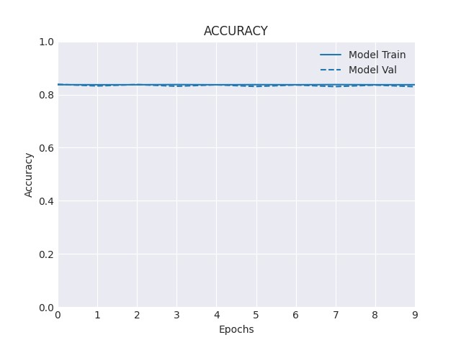
U-Net Results
Model | Train (Accuracy%) | Validation(accuracy %)
U-Net from scratch | 89.1 | 86.4
U-Net fine-tune | 83.6 | 82.9
U-Net from scratch
U-Net fine-tunning

Slide 42
U-Net Results
Model | Train (Accuracy%) | Validation(accuracy %)
U-Net from scratch | 89.1 | 86.4
U-Net fine-tune | 83.6 | 82.9
U-Net from scratch
U-Net fine-tunning

Slide 43
U-Net Results
U-Net from scratch
Model | Train (Accuracy%) | Validation(accuracy %)
U-Net from scratch | 89.1 | 86.4
U-Net fine-tune | 83.6 | 82.9
U-Net fine-tunning

Slide 44
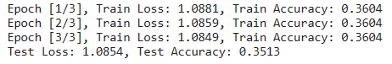
SAM Result

Slide 45
Save the weights
For YOLOv8-seg we saved the best weights in “.pt” format.
The ".pt" extension often indicates that the file is a PyTorch model checkpoint.
For U-Net we saved the best weights in “.h5” format.
The ".h5" extension indicates that the file is saved in the HDF5 format.
For SAM we saved the best weights in “.pth” format.
The ".pth" extension indicates that the file is saved in the pytorch format.

Slide 46
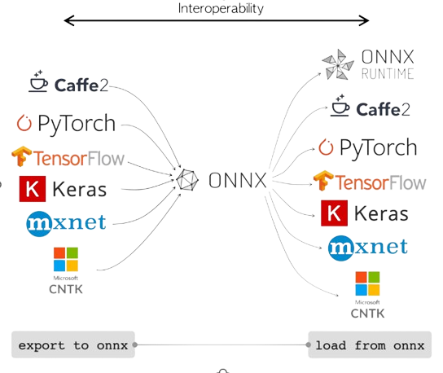
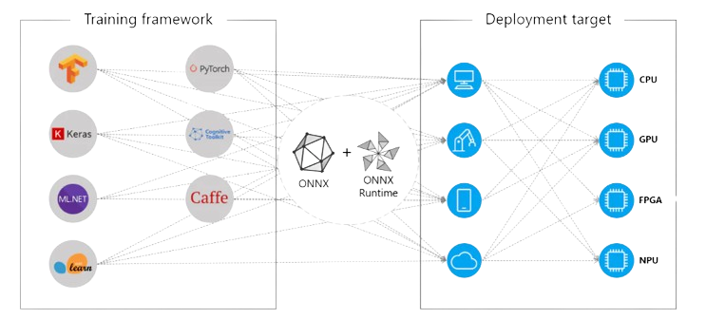
Convert to onnx format

Slide 47
Convert to onnx format

Slide 48
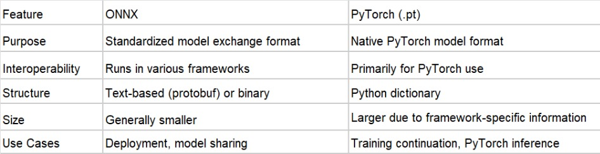
Onnx format

Slide 49
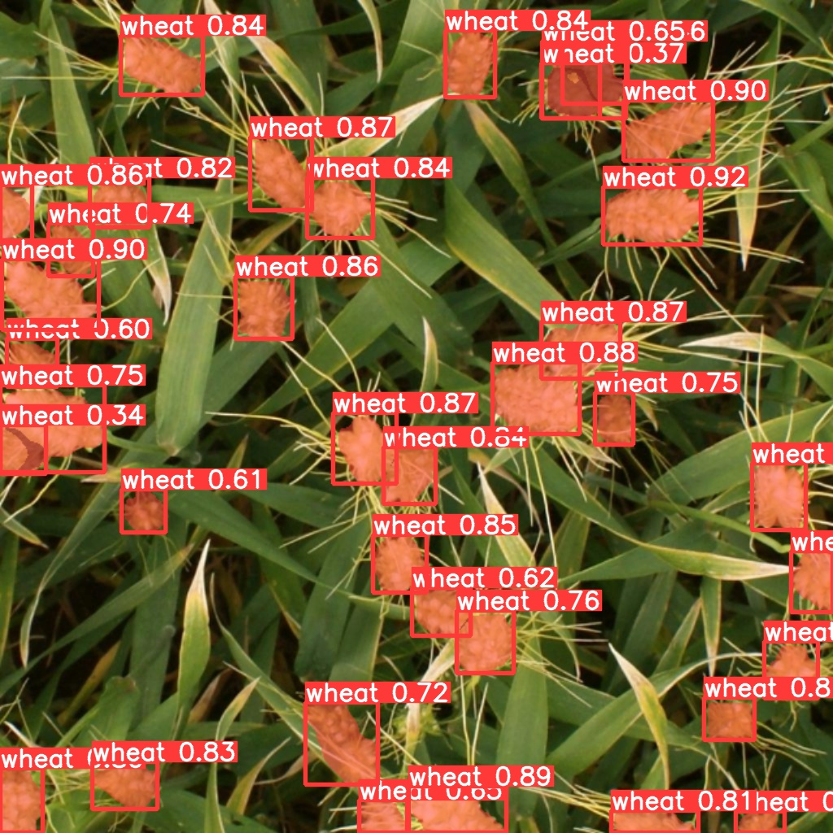
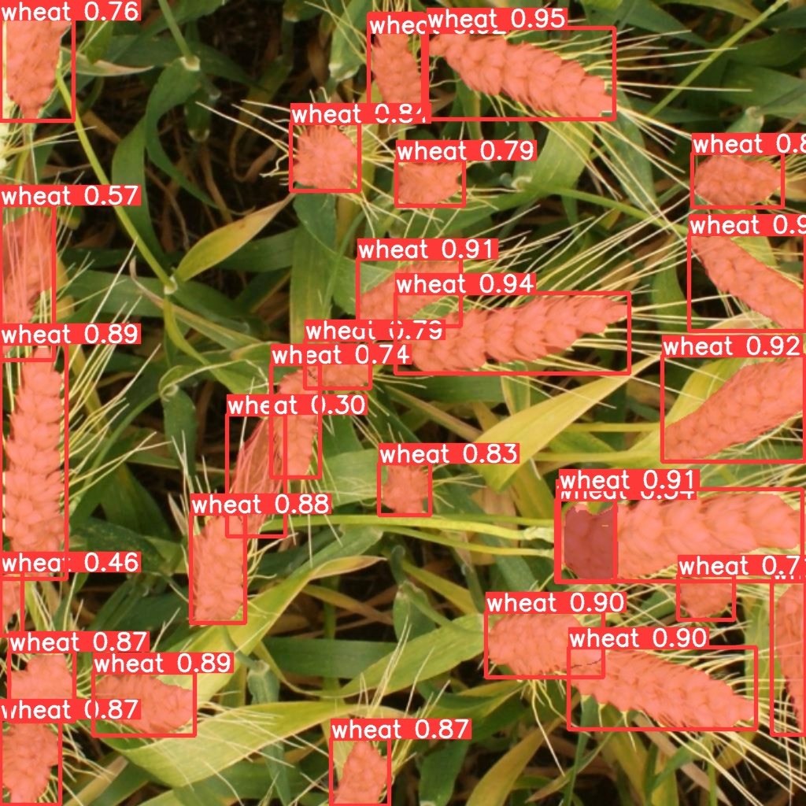
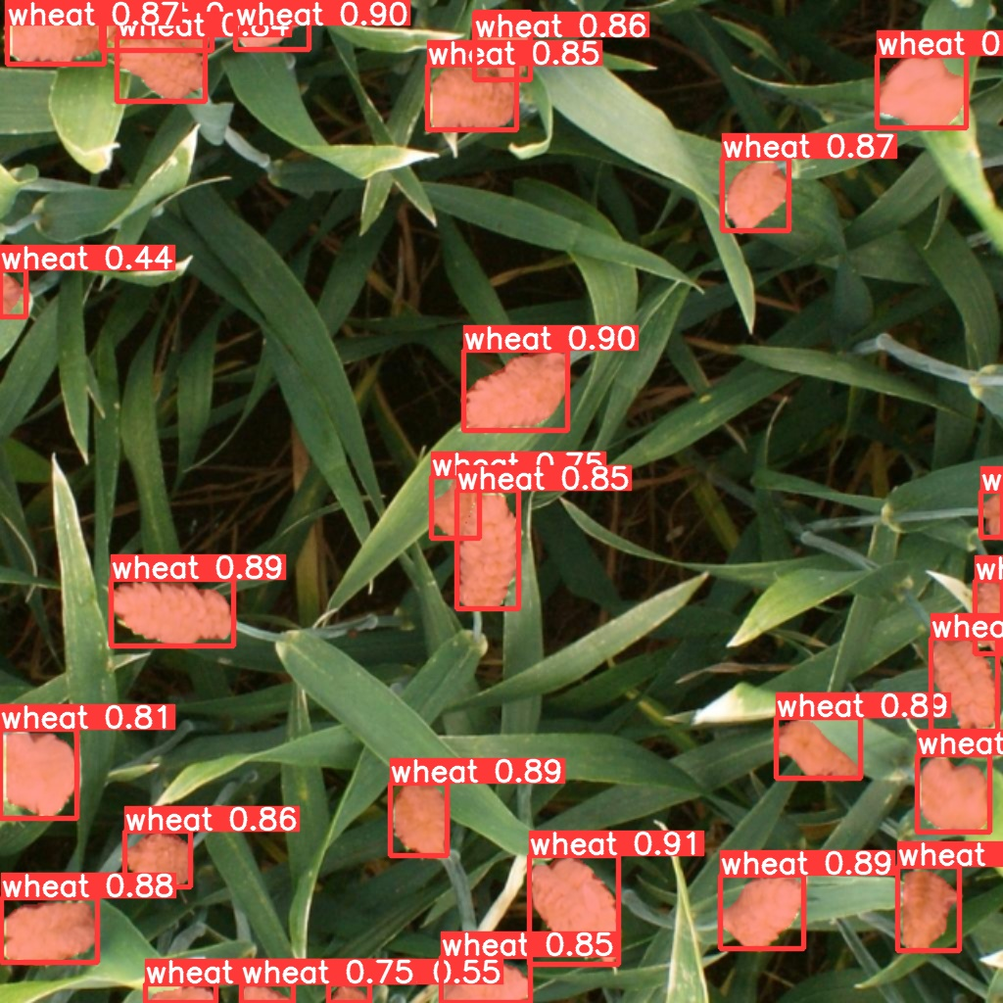
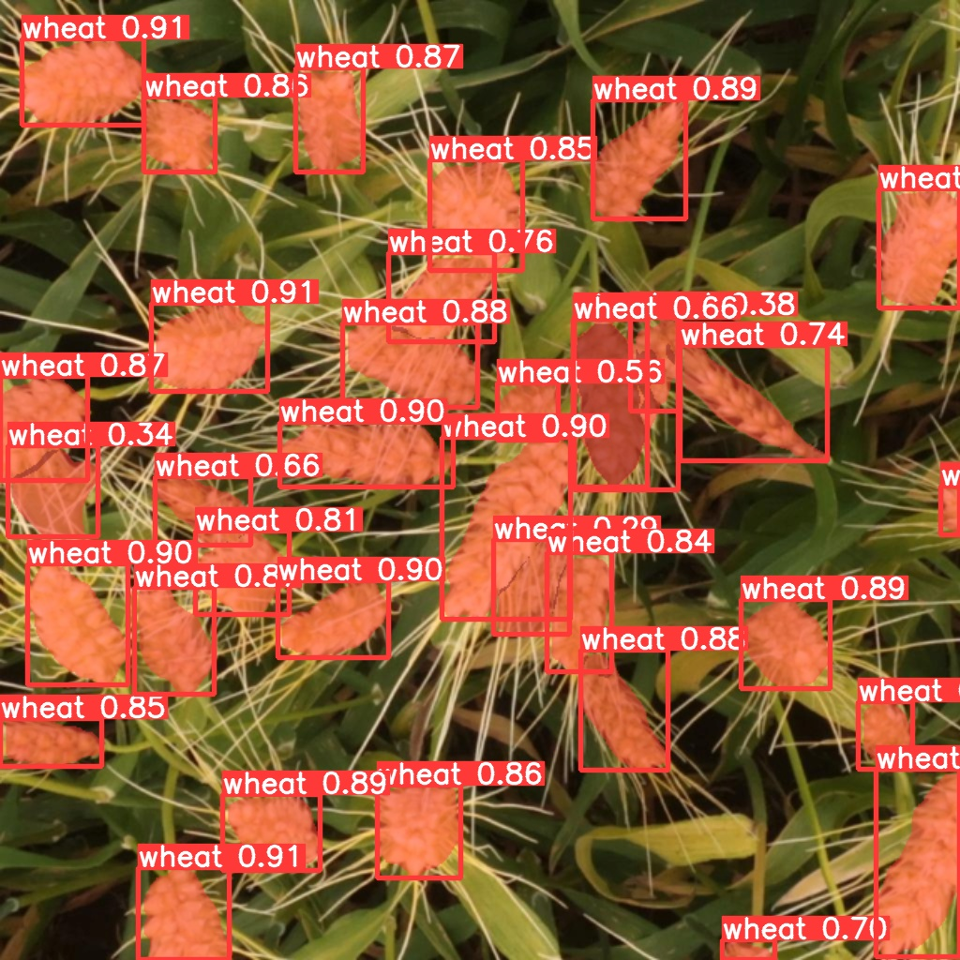
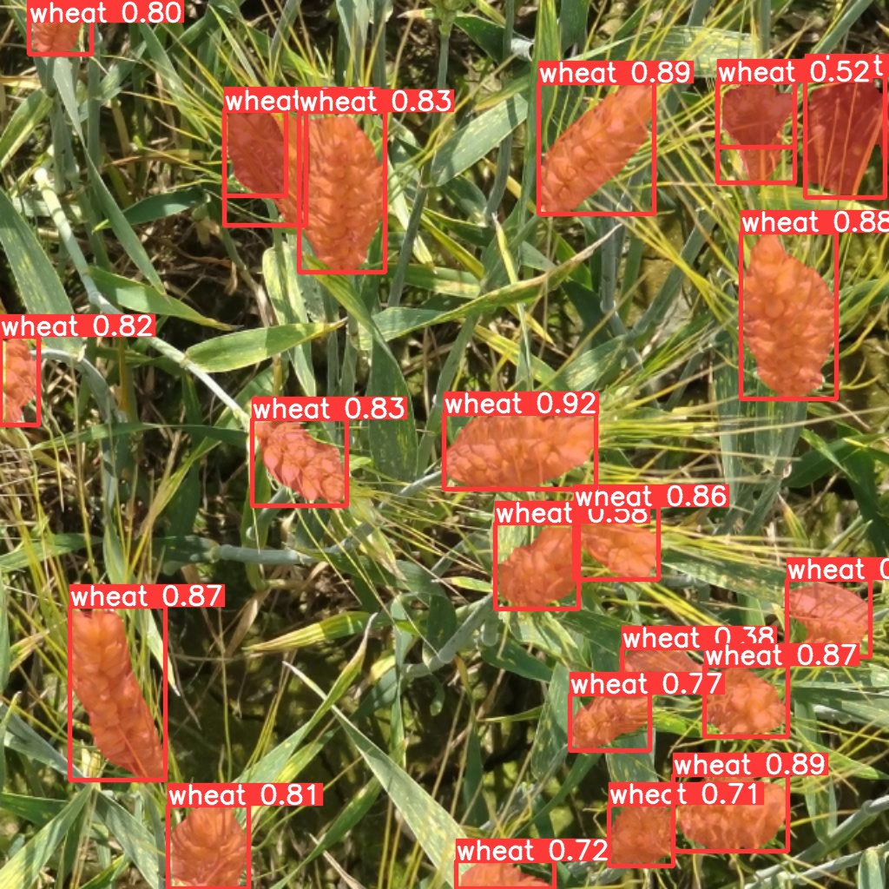
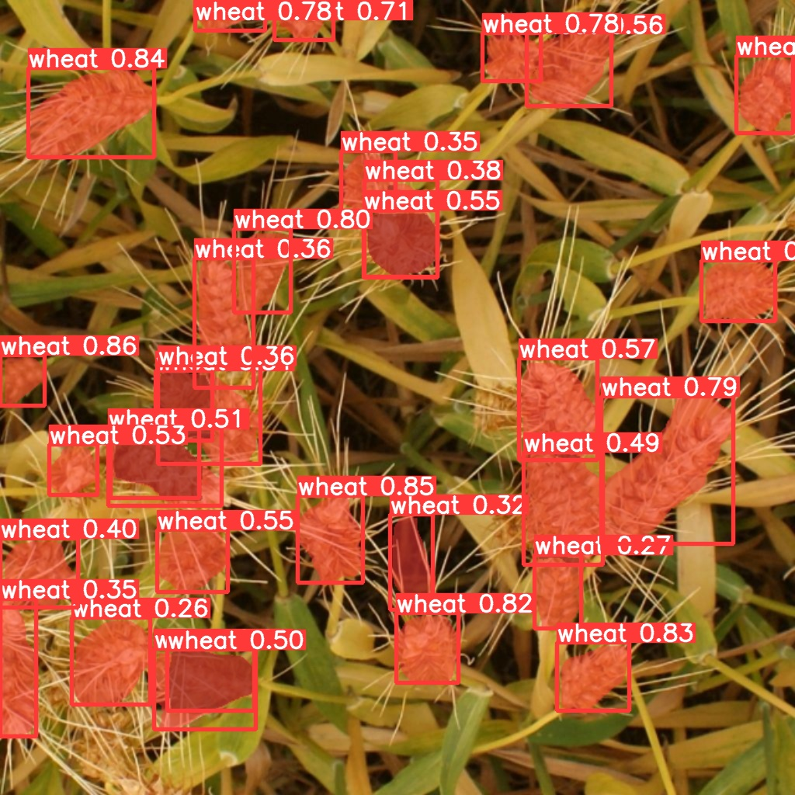
Test images using onnx
Yolov8-seg:

Slide 50
Test images using onnx
Yolov8-seg:

Slide 51
OUR TEAM
FATIMA
AL DARWEESH
LEEN MALLAH
EMAN
AZAIZEH
AQEEL SHATNAWI

Slide 52
Thanks
for
watching

